Slide 1


The Finance Tracker app
Core Features:
Voice input for quick transaction recording
Photo/receipt scanning for expense capture
Dashboard with income, expenses, and profit overview
Transaction history with search and filtering
Quick expense and income entry forms
Transaction categorization system
Basic financial reports and insights
Export functionality for accounting purposes
02

Slide 2


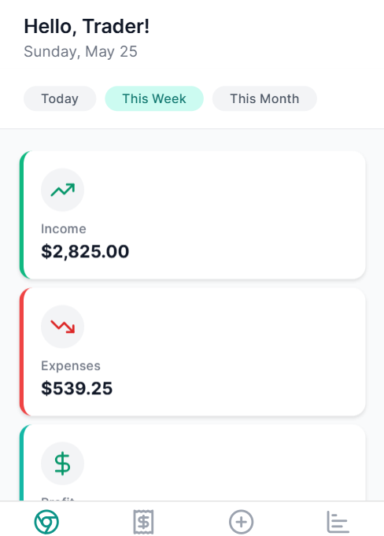
The Finance Tracker app
01

Slide 3

Problem Statement
Shopkeepers in informal markets struggle with rapidly changing supplier prices.
10

Slide 4

Solution
The Finance Tracker app provides small business owners with a powerful yet intuitive way to monitor their financial health. The tab-based interface makes navigation straightforward with dedicated sections for dashboard, transactions, adding new entries, and financial reports.
06

Slide 5
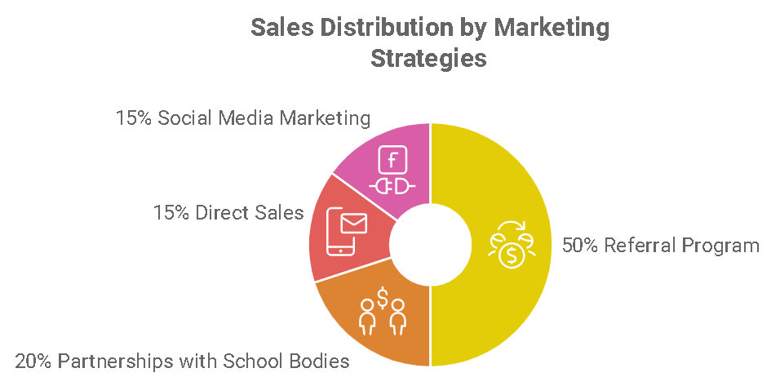
Product
The dashboard provides at-a-glance financial information showing income, expenses, and profit, while the transactions screen allows for easy filtering and searching of past entries.
04

Slide 6



Target Market
2 out 5
Finance Tracker app able to control and adapt its technology as the market evolves and thereby unlock additional revenue streams for its clientele
95%
The reporting section visualizes spending patterns to help business owners identify
123 million
14

Slide 7
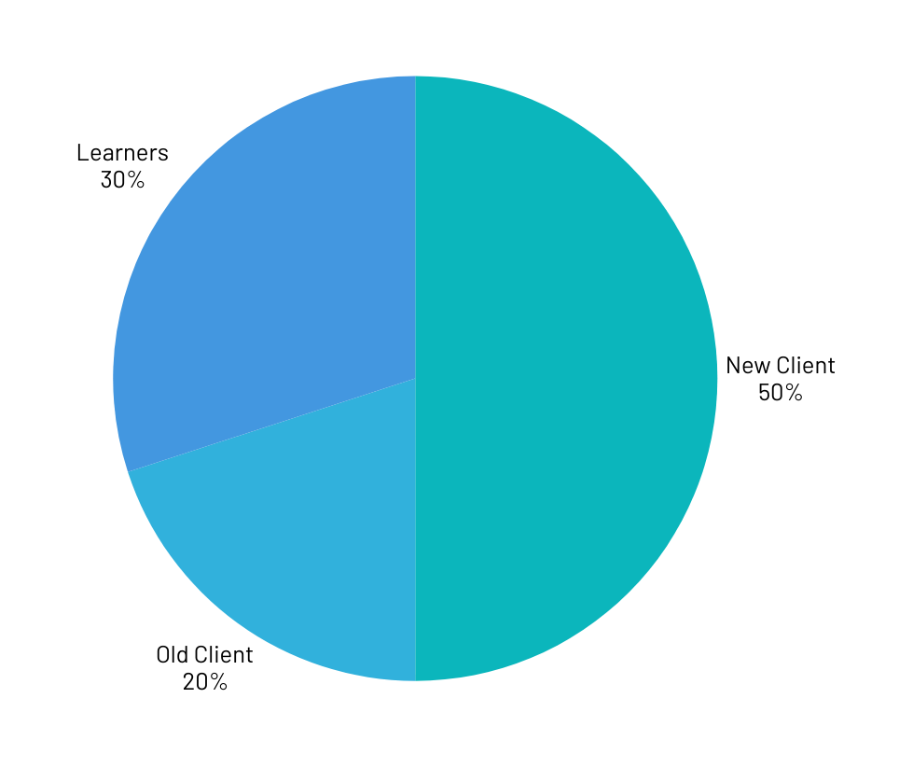
Market Size
We offer free class for learners and client

Slide 8
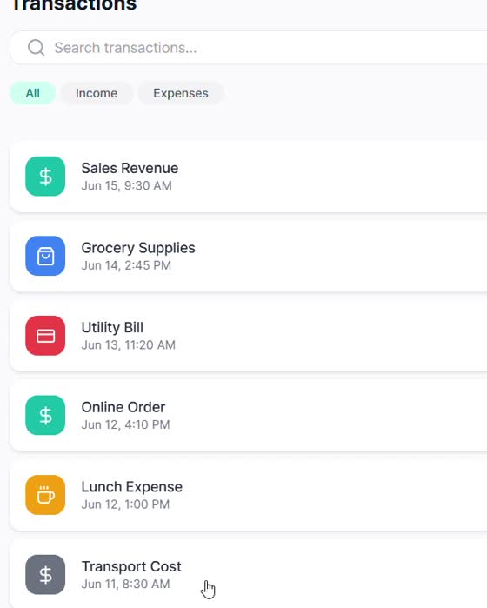
Competitors
Cash register
Finance Tracker app is invoicing, inventory and stock management, and financial reporting, all in one integrated platform.
23

Slide 9

Competitive Advantage
With this solution, even traders who previously didn't track their finances can easily understand their profitability and manage their business more effectively.

Slide 10
Project Traction
Tasks
Month 1
Month 2
Month 3
Month 4
Month 5
Clients
Clients
Clients
Clients
New Clients
Clients
Clients
New Clients
23

Slide 11

Business Model
Finance Tracker app
30 days free
R50 Monthly subscription
23

Slide 12
Go To Market
Visiting small businesses and offer free subscription. Offer free app education.

Slide 13
Social Impact
Voice input for quick transaction recording
Photo/receipt scanning for expense capture
Dashboard with income, expenses, and profit overview
Transaction history with search and filtering
Quick expense and income entry forms
Transaction categorization system
Basic financial reports and insights
Export functionality for accounting purposes

Slide 14
Our Ask
Please rate Finance Tracker app
App is free to download play store/ App store

Slide 15


Team Members
MPHO
WINNIE
Founder of Finance Tracker app
Web development

Slide 16




Thank you!
Whatsapp: 0613716818
Email: mpho.maphalle@gmail.com
17

